Slide 1
Brain Tumor Detection
Brain Tumor Detection using CNN & FastAPI
By: Islam Abd_Elhady
LinkedIn: Islam Abd_Elhady
GitHub: Islam Abd_Elhady

Slide 2
Project Overview

Slide 3
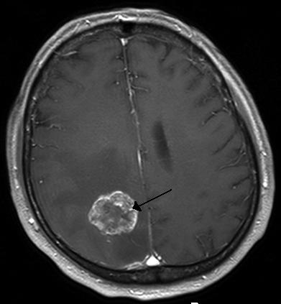
Brain tumor detection is a critical task in medical imaging, as early and accurate detection can significantly impact patient outcomes.

Slide 4
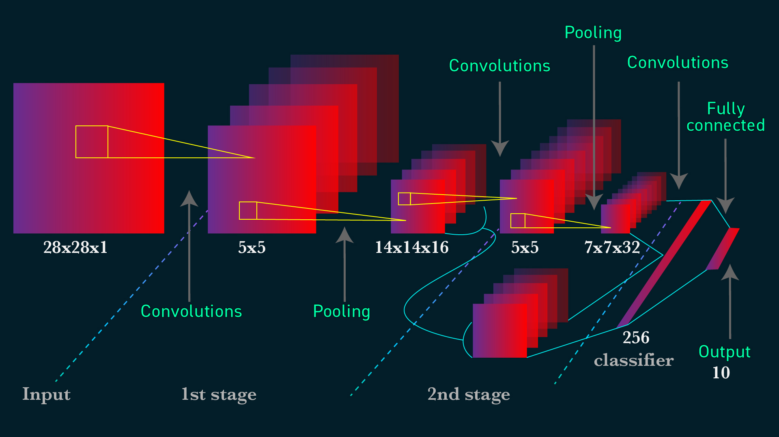
This project leverages deep learning techniques to build a CNN model capable of classifying MRI images into two categories: “Tumor" or “No Tumor"

Slide 5

The trained model is then deployed as an API using FastAPI, providing an accessible interface for users to interact with the model and make predictions.

Slide 6
Project Implementation Stages

Slide 7
Stage 1: Dataset
Dataset from Kaggle: Brain MRI Images for Brain Tumor Detection
This dataset contains a collection of brain MRI.
It provides a valuable resource for developing and testing models.
The dataset is divided into two classes: “Tumor" and “No Tumor"

Slide 8
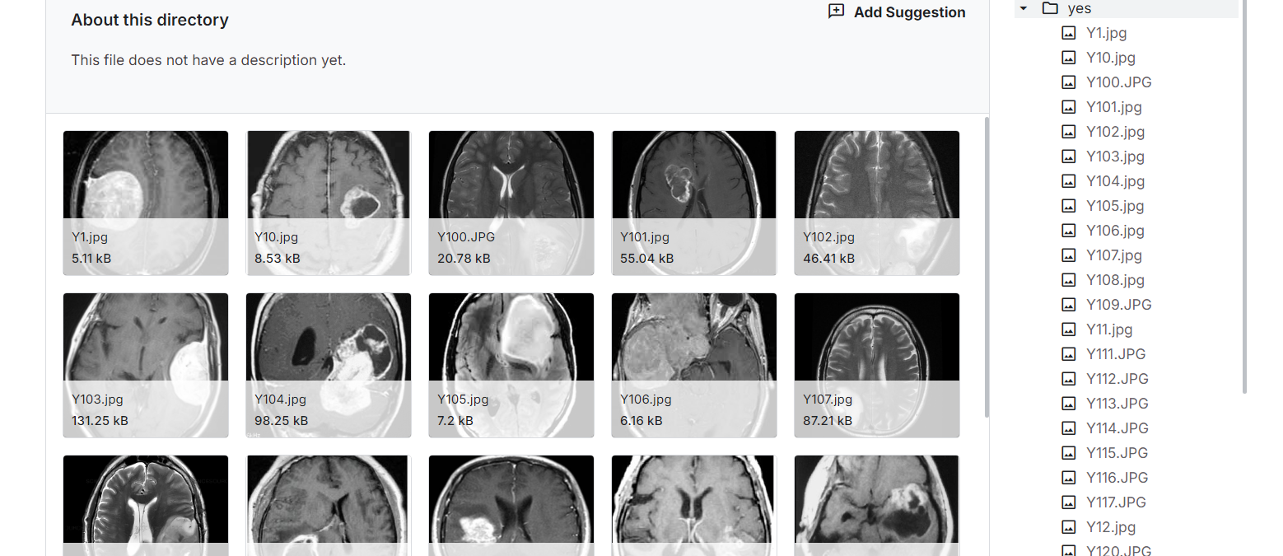

Slide 9
Stage 2: Model Training
Main Stages of Training

Slide 10
1
2
3
Images are loaded, resized to128x128 pixels.
labeled (0 for no tumor, 1 for tumor).
Split into training and testing sets with an 80-20 ratio.
Data Preprocessing
A Sequential CNN is defined with two convolutional layers, max pooling, flattening, and dense layers, using ReLU for hidden layers and softmax for output.
Model Building
The model is compiled with categorical cross-entropy loss and the SGD optimizer. It is trained for 25 epochs with a batch size of 8.
Training

Slide 11
4
5
The model’s performance is evaluated with a classification report, confusion matrix, and accuracy, achieving a highest accuracy rate of 92.16%.
Model Evaluation
Save the entire model to a HDF5 file to be used directly later.
Save the Model

Slide 12
Stage 3: API Endpoints
Model Conversion: After training, the model is saved and loaded into a FastAPI application.
API Definition: FastAPI is used to define endpoints that allow the model to be accessed over HTTP.
  Example: ‘/predict’ endpoint accepts an image, processes it, and returns a prediction.

Slide 13
Flexibility: The API can be integrated with various types of applications, such as web apps, mobile apps, and desktop software.
Ease of Use: Developers can easily send requests to the API and receive predictions, enabling seamless integration into any platform.
Scalability: The API can be deployed in various environments (e.g., cloud, on-premise) and scaled to handle multiple requests.

Slide 14
Stage 4: User Interface (Web Interface)
Connect API to Web Interface.
A simple and user-friendly web interface allows users to upload images and view predictions.

Slide 15
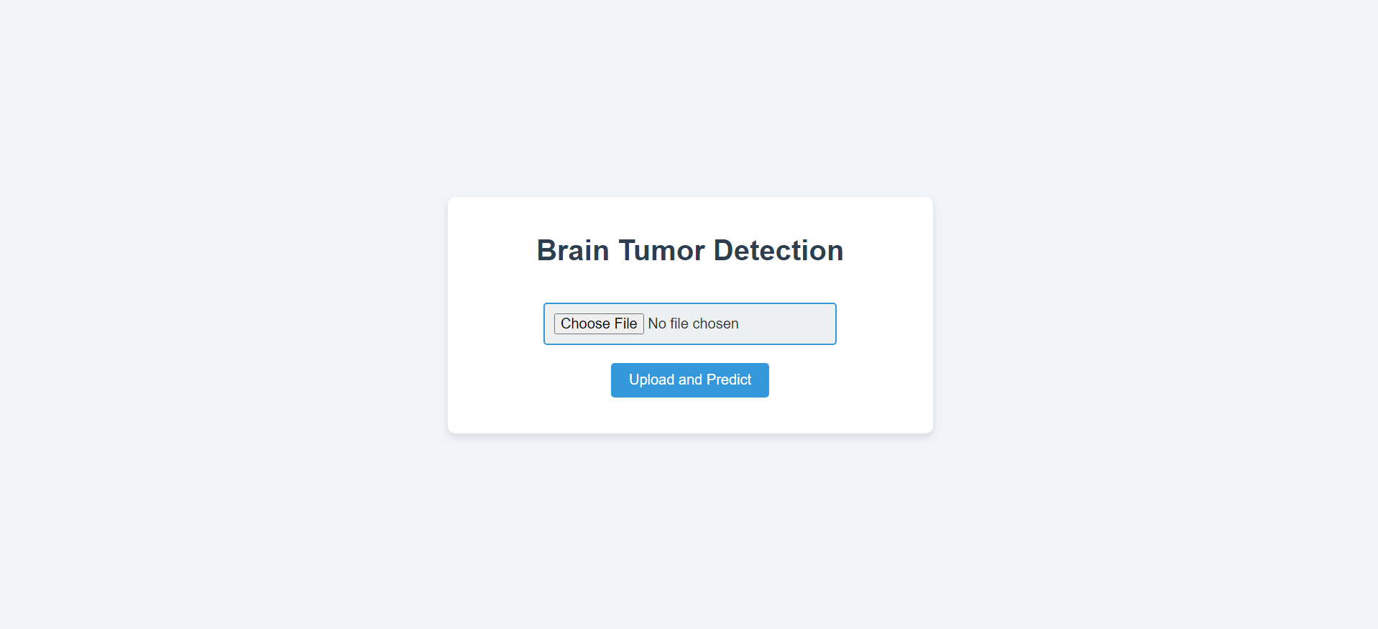

Slide 16
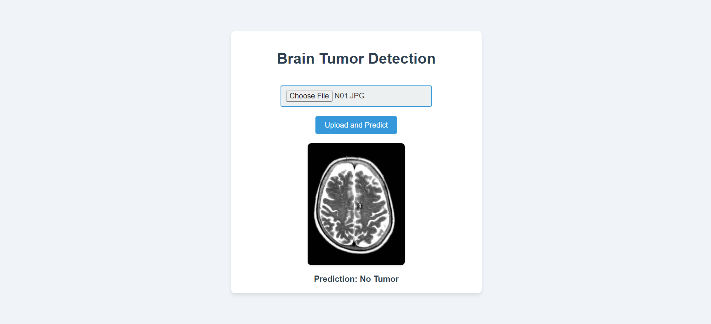

Slide 17
Project link on GitHub
Project Repository: Access the full project on GitHub to view the code, documentation, and deployment details.
Link: https://github.com/Islam-hady9/BrainTumorDetection-API

